Slide 1


06- Implementing Public Key Infrastructure
Ehab Fahmi
Senior Cyber Security Consultant - Instructor

Slide 2
Outlines
6.1- Implement Certificates and Certificate Authorities 6.2- Implement PKI Management

Slide 3
6.1- Implement Certificates and Certificate Authorities
6.2- Implement PKI Management

Slide 4
PUBLIC AND PRIVATE KEY USAGE
Public key cryptography solves the problem of distributing encryption keys when you want to communicate securely with others or authenticate a message that you send to others.
When you want others to send you confidential messages, you give them your public key to use to encrypt the message, The message can then only be decrypted by your private key, which you keep known only to yourself.
When you want to authenticate yourself to others, you create a signature and sign it by encrypting the signature with your private key, You give others your public key to use to decrypt the signature, As only you know the private key, everyone can be assured that only you could have created the signature.

Slide 5
PUBLIC AND PRIVATE KEY USAGE (cont.)
The basic problem with public key cryptography is that you may not really know with whom you are communicating.
The system is vulnerable to man-in-the-middle attacks.
This problem is particularly evident with e-commerce.
How can you be sure that a shopping site or banking service is really maintained by whom it claims?
The fact that the site is distributing public keys to secure communications is no guarantee of actual identity.

Slide 6
PUBLIC AND PRIVATE KEY USAGE (cont.)
How do you know that you are corresponding directly with the site using its certificate? How can you be sure there isn't a man-in-the-middle intercepting and modifying what you think the legitimate server is sending you? various models.
Public key infrastructure (PKI) aims to prove that the owners of public keys are who they say they are.
Under PKI, anyone issuing public keys should obtain a digital certificate.
The validity of the certificate is guaranteed by a certificate authority (CA).

Slide 7
CERTIFICATE AUTHORITIES
The Certificate Authority (CA) is the entity responsible for issuing and guaranteeing certificates.
Private CAs can be set up within an organization for internal communications.
Most network operating systems, including Windows Server, have certificate services.
For public or business-to-business communications, however, the CA must be trusted by each party.
Third-party CA services include IdenTrust, Digicert, Sectigo/Comodo, GoDaddy, and GlobalSign.

Slide 8

CERTIFICATE AUTHORITIES (cont.)
The functions of a CA are as follows:
Provide a range of certificate services useful to the community of users serviced by the CA.
Ensure the validity of certificates and the identity of those applying for them (registration).
Establish trust in the CA by users and government and regulatory authorities and enterprises, such as financial institutions.

Slide 9
PKI TRUST MODELS
The trust model is a critical PKI concept, and shows how users and different CAs are able to trust one another.
Single CA
In this simple model, a single CA issues certificates to users; users trust certificates issued by that CA and no other.
The problem with this approach is that the single CA server is very exposed.
If it is compromised, the whole PKI collapses.

Slide 10
PKI TRUST MODELS (cont.)
Hierarchical (Intermediate CA)
In the hierarchical model, a single CA (called the root) issues certificates to several
intermediate CAs.
The intermediate CAs issue certificates to subjects (leaf or end entities).
This model has the advantage that different intermediate CAs can be set up with different certificate policies, enabling users to perceive clearly what a particular certificate is designed for.
Each leaf certificate can be traced back to the root CA along the certification path.
This is also referred to as certificate chaining, or a chain of trust.
The root's certificate is self-signed.
In the hierarchical model, the root is still a single point of failure.
If the root is damaged or compromised, the whole structure collapses.

Slide 11
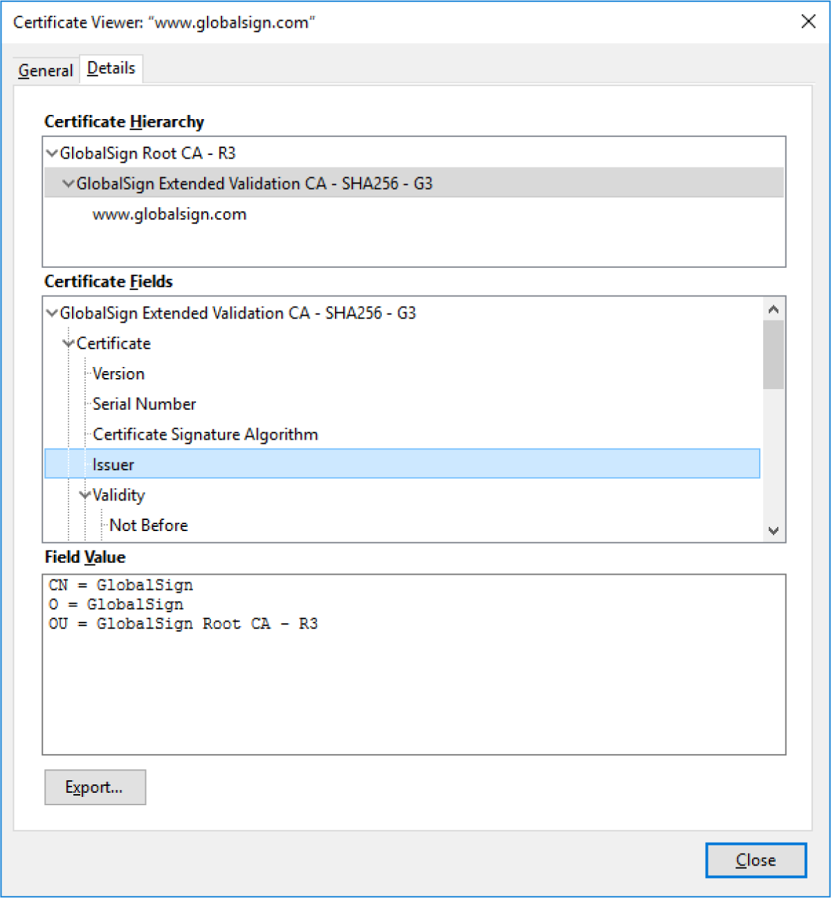
PKI TRUST MODELS (cont.)

Slide 12
PKI TRUST MODELS (cont.)
Online vs. Offline CAs
An online CA is one that is available to accept and process certificate signing requests,
publish certificate revocation lists, and perform other certificate management tasks.
Because of the high risk posed by compromising the root CA, a secure configuration involves making the root an offline CA.
This means that it is disconnected from any network and usually kept in a powered-down state.
The root CA will need to be brought online to add or update intermediate CAs.

Slide 13
REGISTRATION AUTHORITIES AND CSRS
Registration is the process by which end users create an account with the CA and become authorized to request certificates.
The exact processes by which users are authorized and their identity proven are
determined by the CA implementation.
For Example: in a Windows Active Directory network, users and devices can often auto-enroll with the CA just by authenticating to Active Directory.
Commercial CAs might perform a range of tests to ensure that a subject is who he or she claims to be.
It is in the CA's interest to ensure that it only issues certificates to legitimate users, or its reputation will suffer.

Slide 14
REGISTRATION AUTHORITIES AND CSRS (cont.)
When a subject wants to obtain a certificate, it completes a certificate signing request (CSR) and submits it to the CA.
The CSR is a Base64 ASCII file containing the information that the subject wants
to use in the certificate, including its public key.
The CA reviews the certificate and checks that the information is valid.
For a web server, this may simply mean verifying that the subject name and fully qualified domain name (FQDN) are identical, and verifying that the CSR was initiated by the person administratively responsible for the domain, as identified in the domain's WHOIS records.
If the request is accepted, the CA signs the certificate and sends it to the subject.

Slide 15
DIGITAL CERTIFICATES
A Digital Certificate is essentially a wrapper for a subject's public key.
As well as the public key, it contains information about the subject and the certificate's issuer or guarantor.
The certificate is digitally signed to prove that it was issued to the subject by a particular CA.
The subject could be a human user (for certificates allowing the signing of messages, for instance) or a computer server (for a web server hosting confidential transactions, for instance).

Slide 16
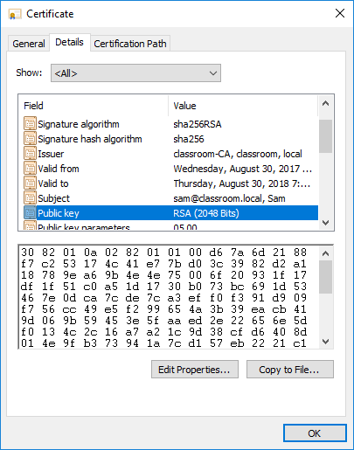
DIGITAL CERTIFICATES (cont.)

Slide 17
DIGITAL CERTIFICATES (cont.)
Digital certificates are based on the X.509 standard approved by the International Telecommunications Union and standardized by the Internet Engineering Taskforce (tools.ietf.org/html/rfc5280).
The Public Key Infrastructure (PKIX) working group manages the development of these standards.
RSA also created a set of standards, referred to as Public Key Cryptography Standards (PKCS), to promote the use of public key infrastructure.

Slide 18

CERTIFICATE ATTRIBUTES
The X.509 standard defines the fields or attributes that must be present in the certificate.
Field | Usage
Serial number | A number uniquely identifying the certificate within the domain of its CA.
Signature algorithm | The algorithm used by the CA to sign the certificate.
Issuer | The name of the CA.
Valid from/to | Date and time during which the certificate is valid.
Subject | The name of the certificate holder, expressed as a distinguished name (DN). Within this, the common name (CN) part should usually match either the fully qualified domain name (FQDN) of the server or a user email address.
Public key | Public key and algorithm used by the certificate holder.
Extensions | V3 certificates can be defined with extended attributes, such as friendly subject or issuer names, contact email addresses, and intended key usage.
Subject alternative name (SAN) | This extension field is the preferred mechanism to identify the DNS name or names by which a host is identified.

